Slide 1
SHOP FOR HOME
TEAM MEMBERS:
RAAVI RAJA
MOHANACHARY NANDINI
ADDULAMALA MADHURI
VARANASI MADHURI

Slide 2
PROBLEM STATEMENT
Shop For Home is a popular Store in the market for shopping the home décor stuff . Due to Covid 19 all the offline shopping stopped. So, the store wants to move to the cloud platforms and wants their own web application.
CONTRIBUTION TO PROJECT :
Raavi Raja – worked on Frontend development
Varanasi Madhuri – worked on Frontend development
Addulamala Madhuri - worked on Backend development
Mohanachary Nandini - worked on Backend development

Slide 3
SOFTWARES USED
1) FRONTEND :
Angular
Boot strap
Angular Material
2) BACKEND :
Spring tool suite
Postgresql

Slide 4
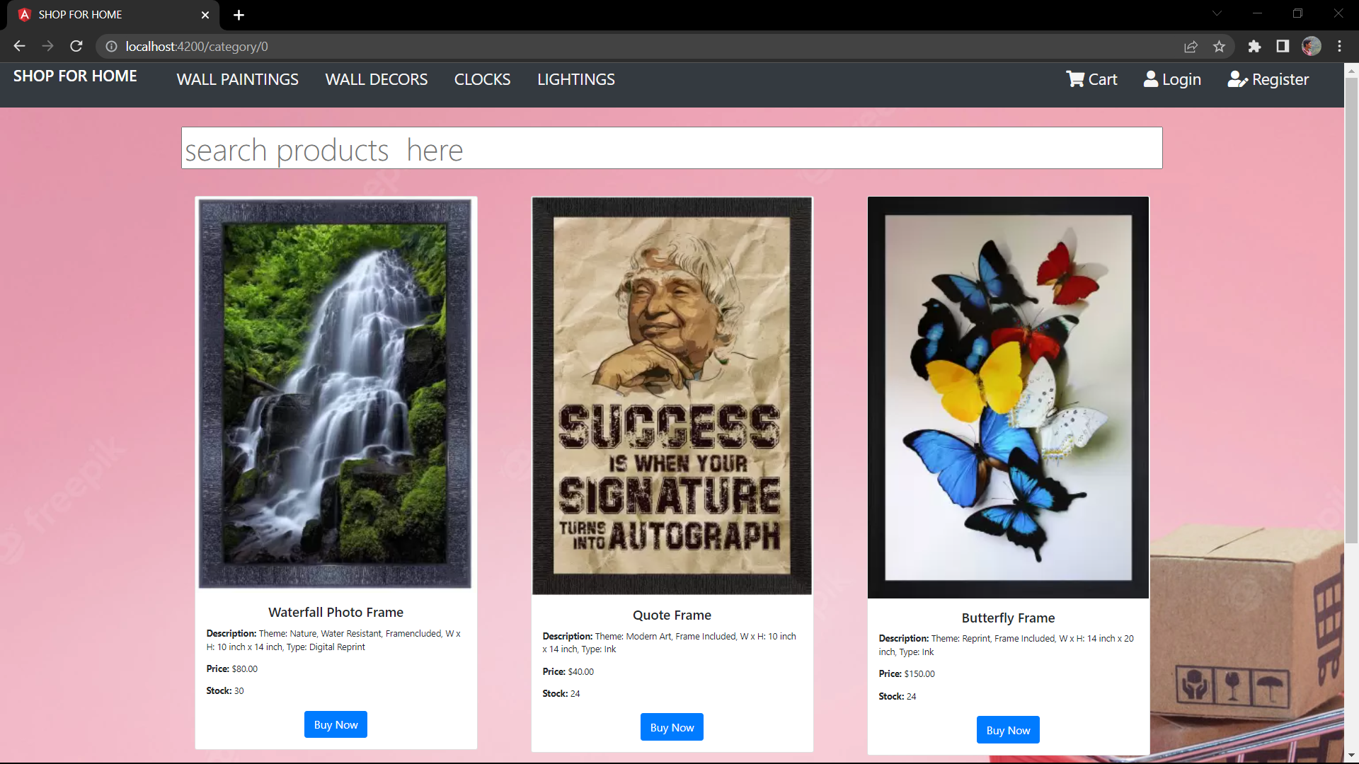
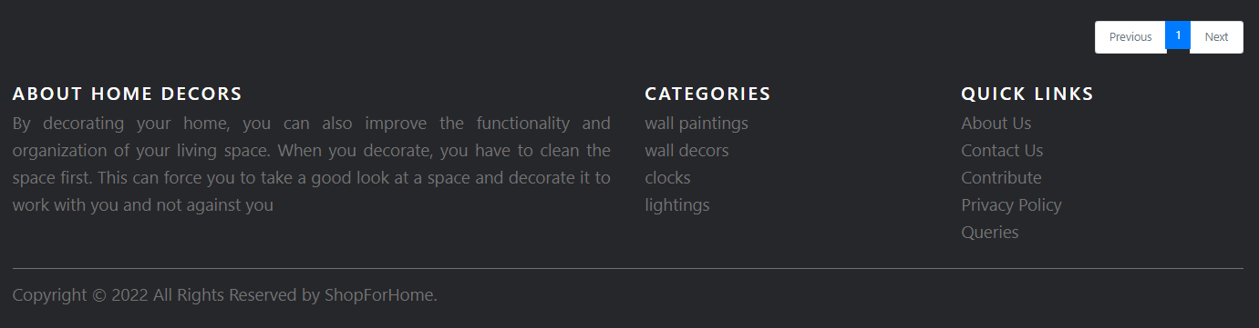
HOME PAGE OF WEBSITE

Slide 5
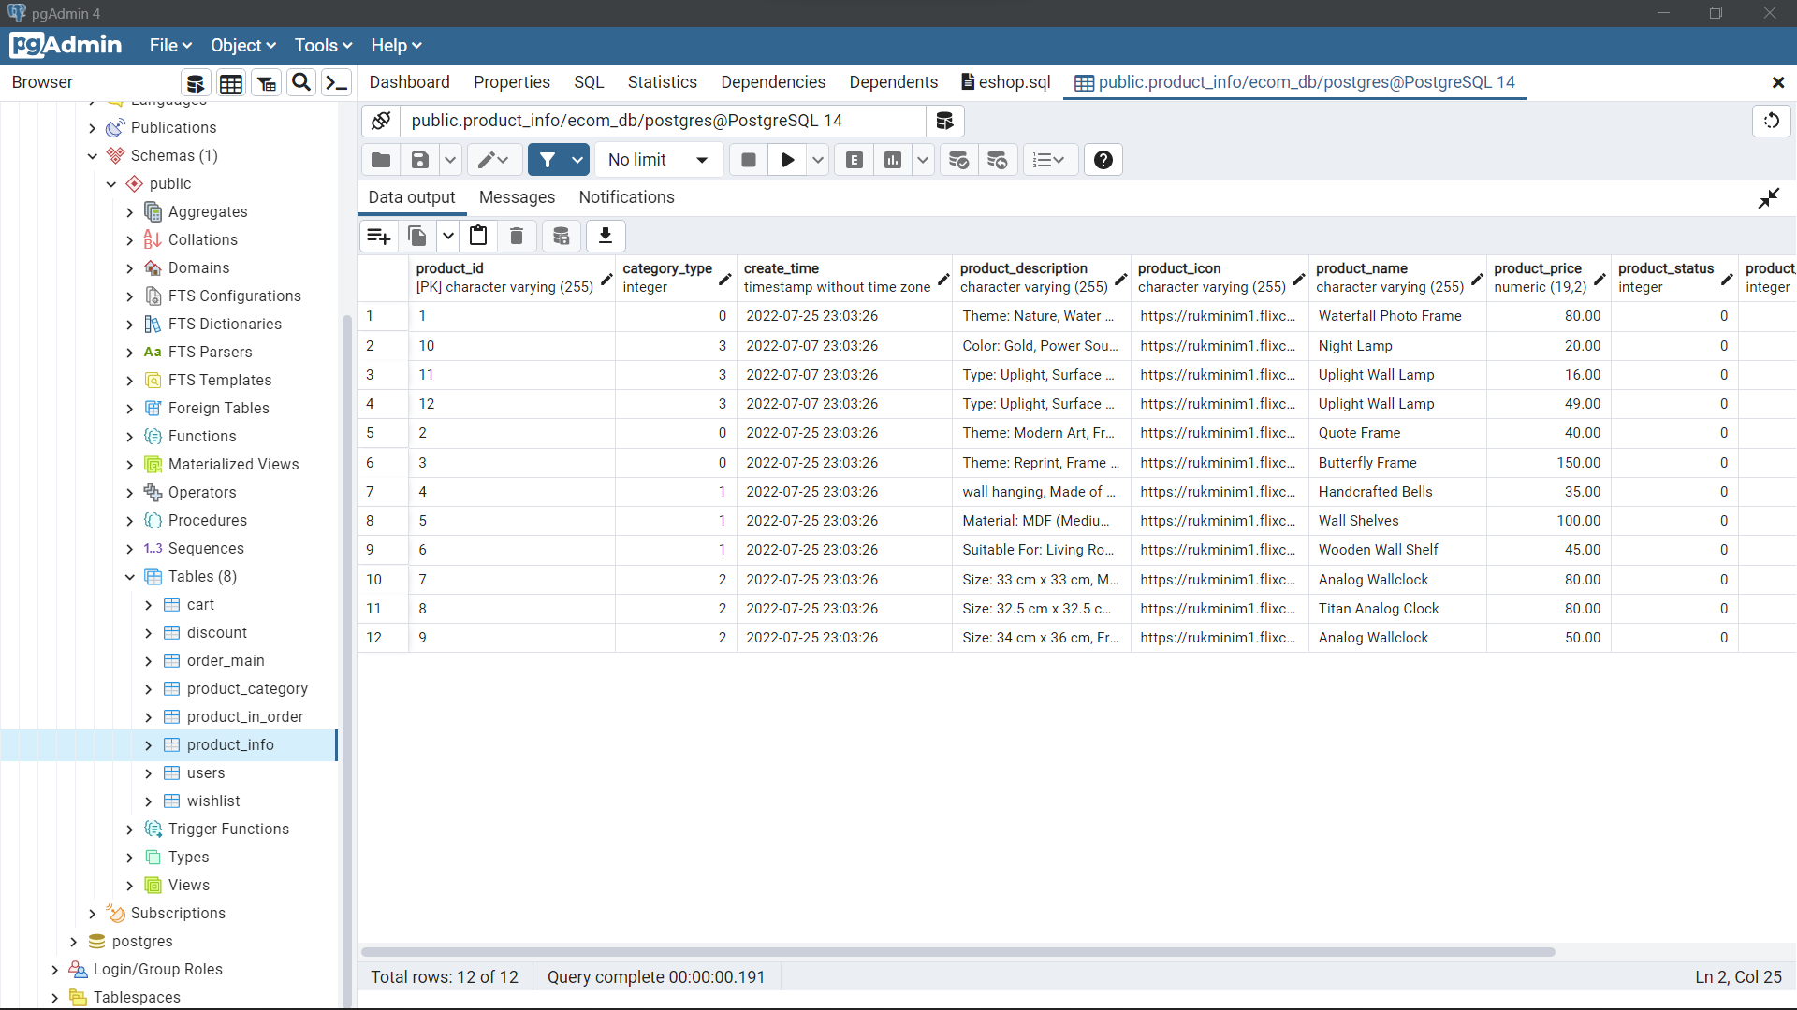
DATA BASE TABLES

Slide 6
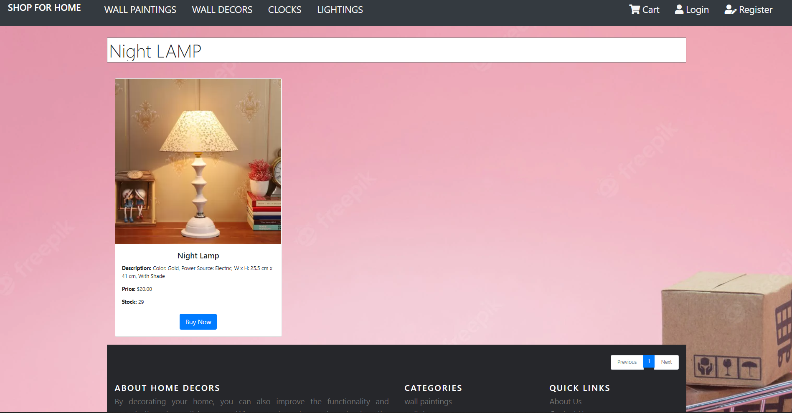
SEARCH FUNCTIONALITY

Slide 7
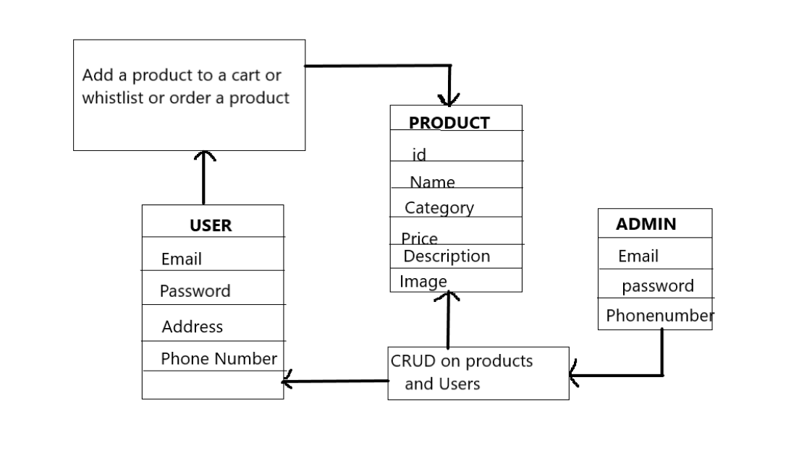
DATA BASE SCHEMA

Slide 8
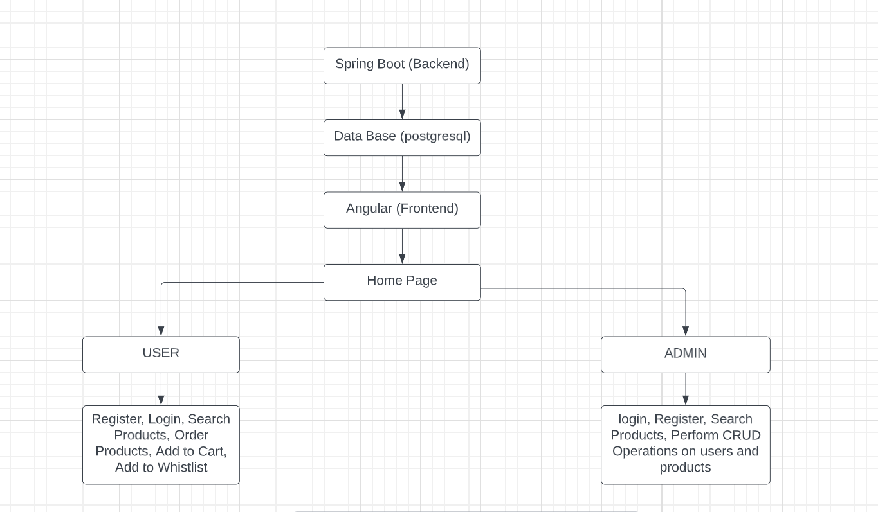
ARCHITECTURE

Slide 9
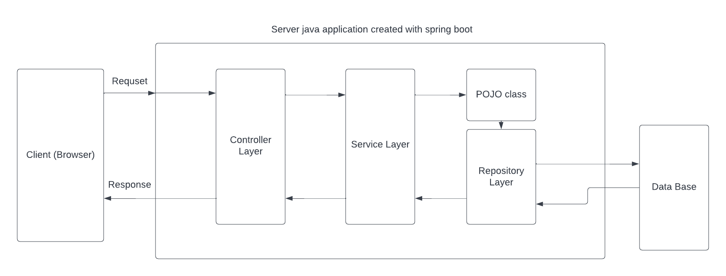
SB WEB APPLICATION LAYERED ARCHITECTURE

Slide 10
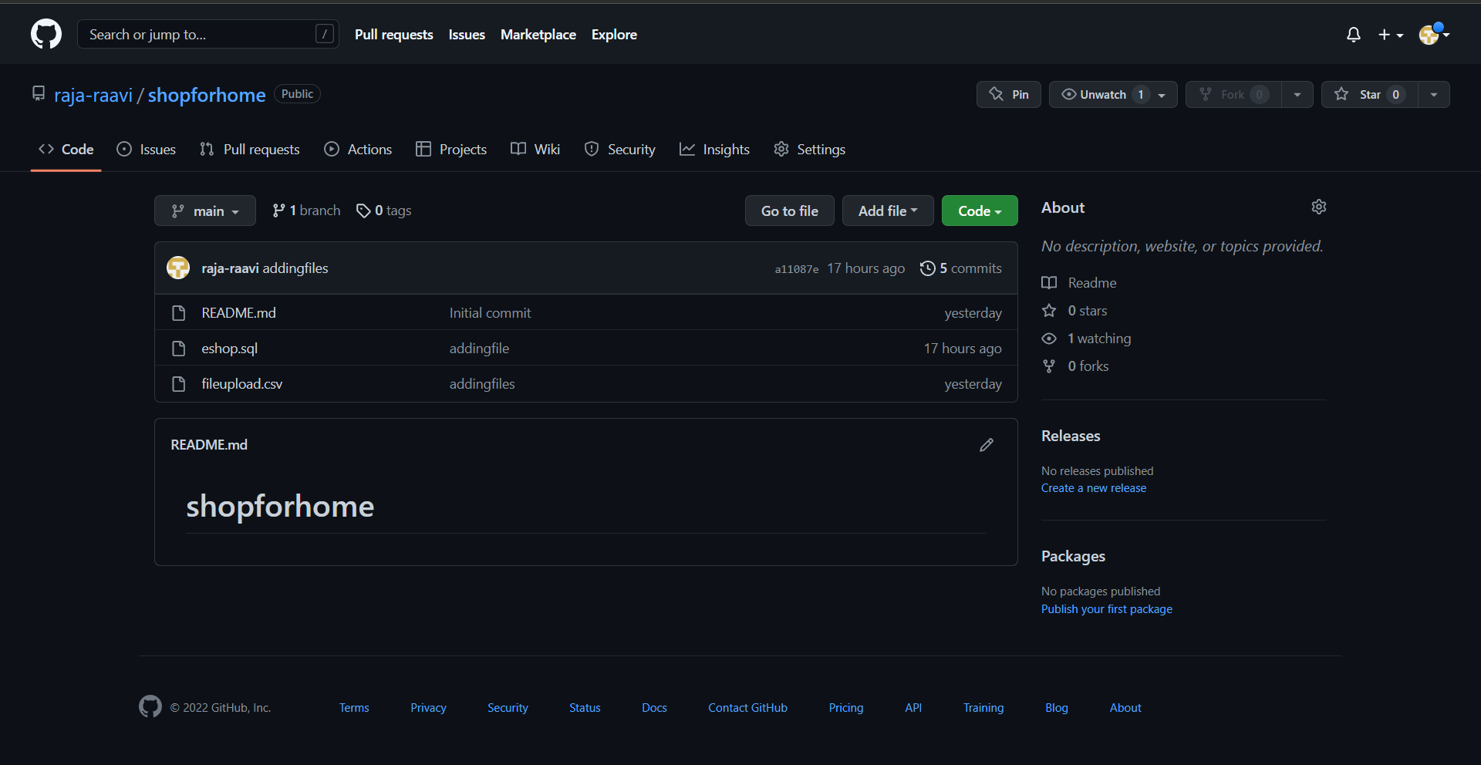
GIT REPOSITORY

Slide 11
CONCLUSION
Thus the Shop For Home web application is developed as the instructions
Since the eight objectives listed in sprint 1 document are all effectively implemented.

Slide 12
THANK YOU

